Slide 1





By: Dylan Sun, Cindy Lee, Kai Yuan Mor, Evan Chiang, Nicole Scheidel, Daniel Choi

Slide 2

1.
Universal mandatory standard for transportation to reduce deaths and injuries from road traffic accidents

Slide 3
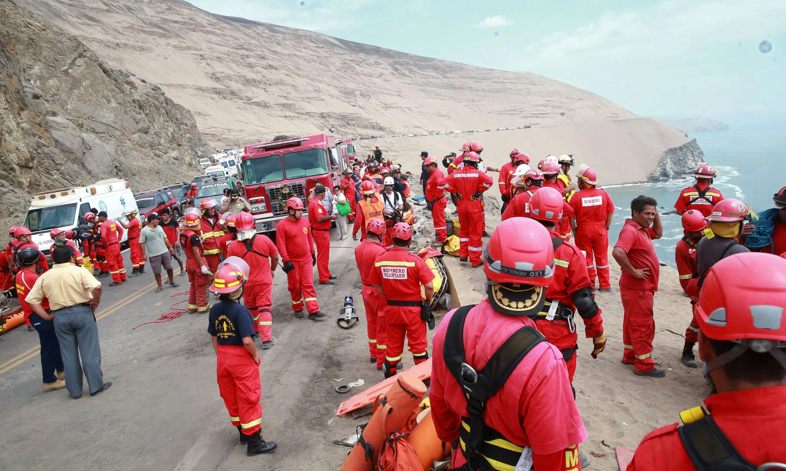
Universal mandatory standard for transportation to reduce deaths and injuries from road traffic accidents - Current Events Update
January 2, 2018
A Peruvian bus carrying 55 members + driver and assistant plunged down a cliff when driving on the notorious Curva del Diablo (Devil’s bend) in Pasamayo. The emergency workers located 51 bodies. The accident became one of the deadliest accidents in Peru along with the 2013 Peru bus disaster.
Firefighters and rescuers working during rescue efforts after the accident. Photograph: HO/AFP/Getty Images
Notes:
http://www.bbc.com/news/world-latin-america-42564573
https://www.theguardian.com/world/2018/jan/02/peru-bus-accident-devils-curve-lima

Slide 4
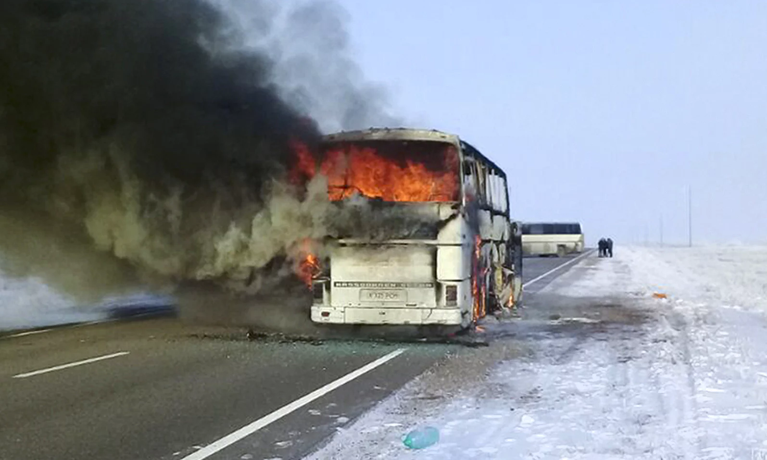
Universal mandatory standard for transportation to reduce deaths and injuries from road traffic accidents - Current Events Update
January 18, 2018
A bus travelling along a road in the Aktau region of Kazakhstan caught fire, killing 52 Uzbek migrant workers. On the next day, the investigators stated that the bus caught fire due to the use of an open flame cooker as a device for heating as well as the presence of gasoline containers for refueling
A picture provided by the Kazakh emergency situations ministry shows the burning bus on a road in the Aktobe region.
Photograph: AP
Notes:
http://www.bbc.com/news/world-asia-42729597
https://www.theguardian.com/world/2018/jan/18/kazakhstan-bus-fire-kills-people-uzbekistan

Slide 5
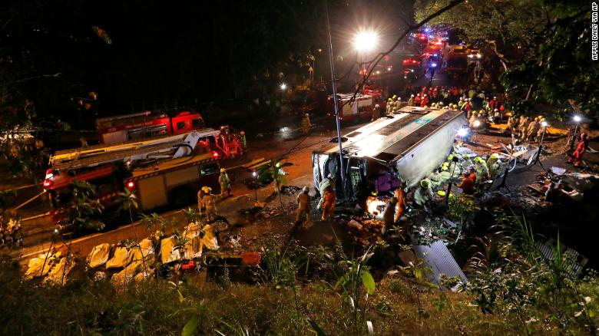
Universal mandatory standard for transportation to reduce deaths and injuries from road traffic accidents - Current Events Update
February 10, 2018
19 were killed and 65 were injured after a double-decker bus in the Tai Po area of Hong Kong crashed. Because the bus was late for 10 minutes near the Sha Tin racecourse, the bus driver quarreled with a passenger before driving at a very high speed.
Firemen working at the scene where the double-decker bus crashed
Notes:
https://www.theguardian.com/world/2018/feb/10/bus-topples-over-in-hong-kong-tai-po
https://www.nytimes.com/2018/02/10/world/asia/hong-kong-bus-crash.html
http://www.thestandard.com.hk/section-news.php?id=192755&sid=11

Slide 6
Universal mandatory standard for transportation to reduce deaths and injuries from road traffic accidents - Current Events Update
March 14, 2018
A bus collided with a car on a highway in the Kandahar province of Afghanistan, leaving at least seven dead and twenty-seven injured. The accident proves that much of the Afghan transport infrastructure remain undeveloped today.
The Vulnerability of Afghanistan & Kandahar
Historical Record:
August 20, 2011 - 35 killed in bus crash in highway between Kandahar and Kabul
May 8, 2016 - 73 killed in collision among two buses and a fuel tanker (same highway)
September 4, 2016 - bus and fuel tanker collision, at least 36 dead
Notes:
http://www.avapress.com/en/news/160053/17-killed-24-injured-in-bus-crash-kandahar
https://www.washingtonpost.com/world/asia_pacific/afghan-official-7-killed-in-a-traffic-accident-in-the-south/2018/03/14/1a213088-2773-11e8-a227-fd2b009466bc_story.html?utm_term=.914b7fdae7c6

Slide 7

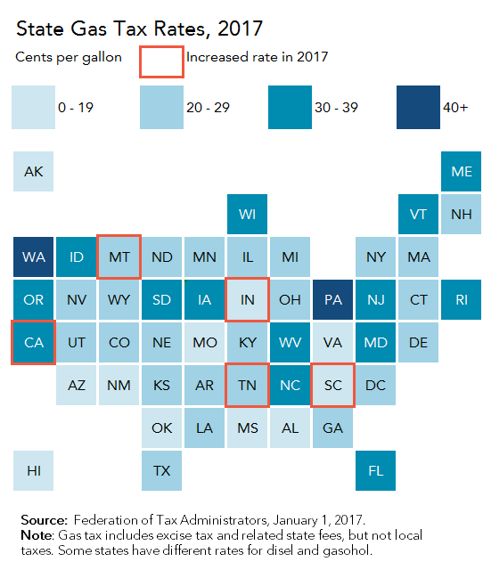
Universal mandatory standard for transportation to reduce deaths and injuries from road traffic accidents - Position of Key Players
The United States of America
President Trump unveiled an infrastructure plan
Allocate 200 billion dollars to spur private investors, 1.5 trillion dollars in public infrastructure projects
February 14 → Trump endorses a 25 cent increase in gas and diesel taxes to help pay for the infrastructure
Source: Federation of Tax Administrators, January 1 2017
Notes:
https://edition.cnn.com/2018/02/14/politics/trump-gas-tax/index.html
http://www.taxpolicycenter.org/taxvox/four-facts-trumps-infrastructure-week-0
http://www.bikeleague.org/content/new-details-president-trump%E2%80%99s-infrastructure-plan

Slide 8

Universal mandatory standard for transportation to reduce deaths and injuries from road traffic accidents - Position of Key Players
The United Kingdom
Least road fatalities compared to Africa
Think! - governmental campaign that promotes British traffic laws and promotes concerns by directing specifically to the government’s website
Africa
Continues to remain as continent most vulnerable to road accidents
Held the 2017 Africa Road Safety Conference in Cape Town, South Africa
Plans to implement the Global Plan for the Decade of Action and the African Road Safety Action Plan
Notes:
https://www.premiumtimesng.com/foreign/africa/247084-650-killed-daily-african-road-accidents-un.html
http://think.direct.gov.uk/

Slide 9





Universal mandatory standard for transportation to reduce deaths and injuries from road traffic accidents - Blocs that may emerge
Canada, Australia, New Zealand
Have established laws on all categories
Portugal, France, Russia
Similar laws on: child restraint laws, seat-belt laws, helmet law,drink driving law
Ethiopia, Laos, Republic of Congo
LEDC countries that have high road traffic mortalities and do not impose most of the categories

Slide 10

Universal mandatory standard for transportation to reduce deaths and injuries from road traffic accidents - Other Information
Global Road Safety Week 2017
Slow Down Days
Campaigns in Schools
Activities involving parliamentarians
Symposia
Vigils for road traffic victims

Slide 11

2.
Methods to establish a comprehensive and effective healthcare system

Slide 12

Methods to establish a comprehensive and effective healthcare system- Current Events Update
February 14th, 2018 and October 1st, 2017
Two mass shootings Reigniting debate between gun control and mental health
Lawmakers in US recognizing mental healthcare as a national imperative
Republicans + democrats both talking about giving federal support to local programs that identifies and treats mental illness across the USA

Slide 13

Methods to establish a comprehensive and effective healthcare system- Current Events Update
3D-printing technology could bring drastic change to the healthcare industry
Flexible technology
September 18th, 2017: Pohang University
Used 3D printing to develop bio-blood vessels (BBV) from boink made vascular tissues
Reduces cost of medical treatment, cost-efficient

Slide 14
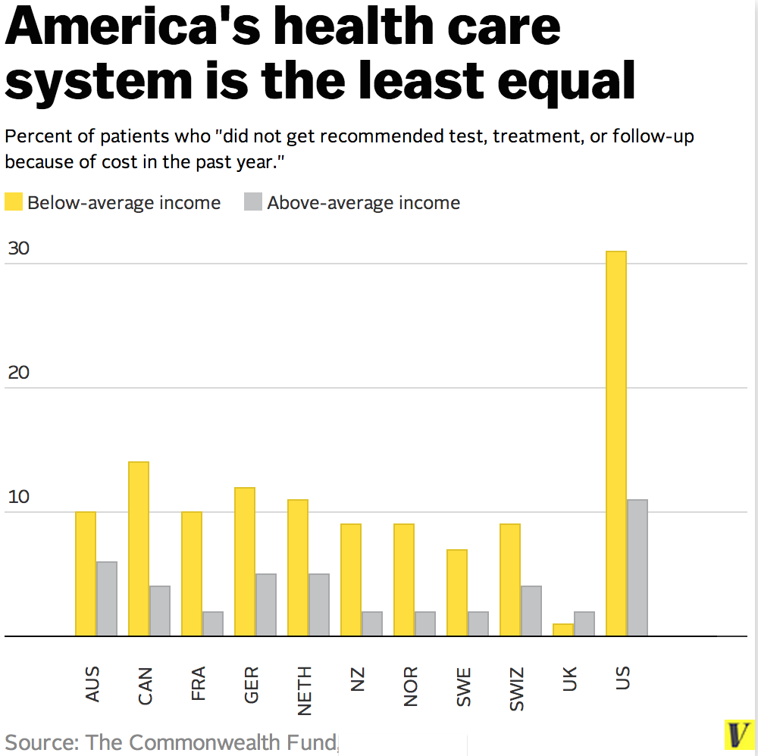
Methods to establish a comprehensive and effective healthcare system- Position of Key Players
The United States of America
America spends on average $5000 more per person than other wealthy nations
A massive amount of wasted, or mis-administered medication
Absurd amount of profit to production cost by private health-care firm
Massive profits by private firms drive up health costs

Slide 15
Methods to establish a comprehensive and effective healthcare system- Position of Key Players
India
4.02% GDP spendings on healthcare system
All citizens supposingly access to healthcare, although a limit on that access causes many household to seek private healthcare
Much higher cost for normal citizens
Less than 20% of the population is covered by any form of healthcare
Luxemburg
Every citizen contributes 5.44% gross income into healthcare program
86% of total health expenditure comes from public sources
99% of the population is covered by the healthcare system
100% of all hospitals are state run, and free to access at anytime

Slide 16
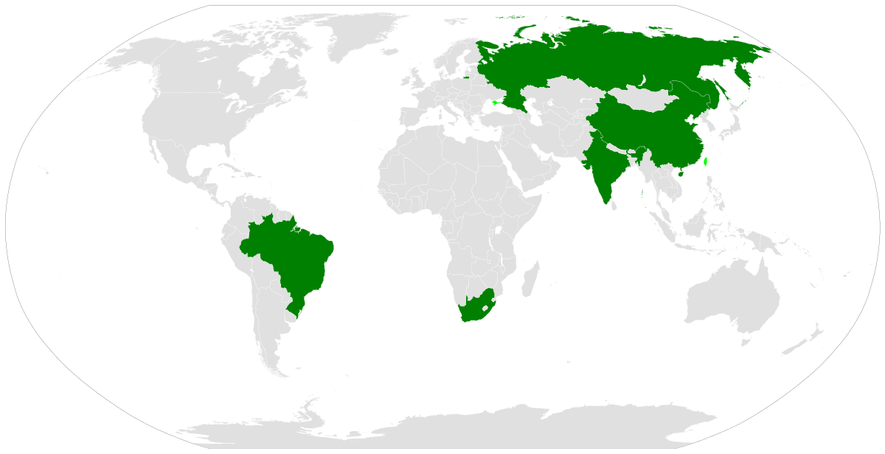
Methods to establish a comprehensive and effective healthcare system-Blocs that may merge
European Union
-Home to many nations with leading healthcare systems, all capable all working together to universalize healthcare for the entire continent
BRICS countries (Brazil, Russia, India, China, South Africa)
-Emerging economies all working together economically, and improvements to global health through the exchange of informations
Small Island Developing States (SIDS)
-group of developing countries in the caribbean and Pacific regions working together to combat common threats of the vulnerability and burden of disease

Slide 17

3.
The question of mitigating the impact of HIV/AIDS on socio-economic development

Slide 18
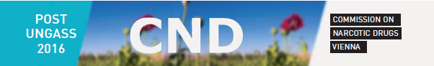
The question of mitigating the impact of HIV/AIDS on socio-economic development - Current Events Update
March 15, 2018
The 61st Session of the Commission on Narcotic Drugs in Vienna shone light on the increase of HIV prevalence within drug users, noting a 33% from 2011-2015. This conference marked the need for low to middle income countries to invest more on preventing HIV in drug users.
The Logo of the 61st Commission of Narcotic Drugs in Vienna
Photograph: UNAIDS
Notes:
https://www.unodc.org/unodc/en/commissions/CND/session/61_Session_2018/session-61-of-the-commission-on-narcotic-drugs.html

Slide 19

The question of mitigating the impact of HIV/AIDS on socio-economic development - Current Events Update
March 16, 2018
In 2011, the National and Kapodistrian University in Athens launched a program that provided safe condoms and needles to victims of HIV, often those forced into unemployment by the recession. When the project ended recently, Athens experienced a 78% reduction in HIV infections.
Salif Keita performs for UNAIDS Fundraising in Athens, March 1 2018
Photograph: UNAIDS
Notes:
http://www.unaids.org/en/resources/presscentre/featurestories/2006/march/20060303greeceopera
http://www.unaids.org/en/resources/presscentre/featurestories/2018/march/20180316_greece

Slide 20

The question of mitigating the impact of HIV/AIDS on socio-economic development - Position of Key Players
Northern Africa
Experience less HIV infections due to better antiretroviral treatment
Focus is mainly on preventing a widespread HIV epidemic to spread from Sub-Saharan Africa
Horn of Africa
Experiences relatively low HIV infection rates due to the Muslim practices in many of the nations
Has a similar focus as Northern Africa, only with more urgency considering the high infection rates in East Africa
Are not as capable to combat HIV as Northern Africa
Notes:
http://files.unaids.org/en/media/unaids/contentassets/documents/epidemiology/2012/gr2012/20121120_UNAIDS_Global_Report_2012_with_annexes_en.pdf
http://ams.ac.ir/AIM/NEWPUB/07/10/4/0012.htm

Slide 21
The question of mitigating the impact of HIV/AIDS on socio-economic development - Position of Key Players
Sub-Saharan Africa
Experiences both high HIV prevalence rates and the inability to treat those diseases
Focuses on effective treatment on the national level, but many regional authorities tend to ostracize patients with HIV from healthcare systems
USA and Asia
The USA, Russia, and China have all experienced and still experience high rates of HIV, but are capable of early identification and treatment
Southeast Asia and South Asia are starting to see a sharp decline in HIV prevalence using many of the methods used by the USA, Russia, and China
Notes:
http://www.unaids.org/globalreport/documents/20101123_GlobalReport_full_en.pdf
https://www.avert.org/professionals/hiv-around-world/western-central-europe-north-america/usa
http://www.policyproject.com/pubs/countryreports/VIET_SEI.pdf

Slide 22
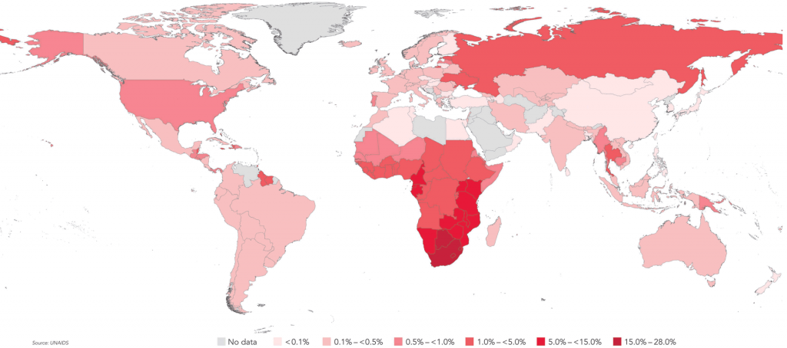
The question of mitigating the impact of HIV/AIDS on socio-economic development - Blocs that may merge
Northern Africa and the Horn of Africa; South and Southeast Asia
All have a relatively low infection rate and would focus more on preventing the spread of the disease
Sub Saharan Africa
All have an extremely high infection rate and would focus more on finding cost-effective treatment of the disease
USA, Russia, China
All have found effective treatment against HIV/AIDS after experiencing high infection rates
Map of the world by infection rates of HIV
Photograph: Max Roser, “HIV/AIDS”. Published online at OurWorldinData.org
Notes:
(using information from above sites)

Slide 23

The question of mitigating the impact of HIV/AIDS on socio-economic development - Other Information
There are...
36.7 million people living with AIDS
20.9 million people on antiretroviral therapy
1.8 million people that has been newly infected with AIDS
7 out of 10 pregnant mothers on antiretroviral treatment
A man living with cryptococcal meningitis, an advanced stage of AIDS
Photograph: James Oatway, WHO
Notes:
http://www.unaids.org/en/
http://www.who.int/hiv/en/

